Slide 1

CEREBRO
Real-Time Neurodivergent Classroom Assistant
AI-powered Chrome Extension that transforms lectures into adaptive learning experiences
Team Cerebro • Education & Neurodivergent Learning Track

Slide 2
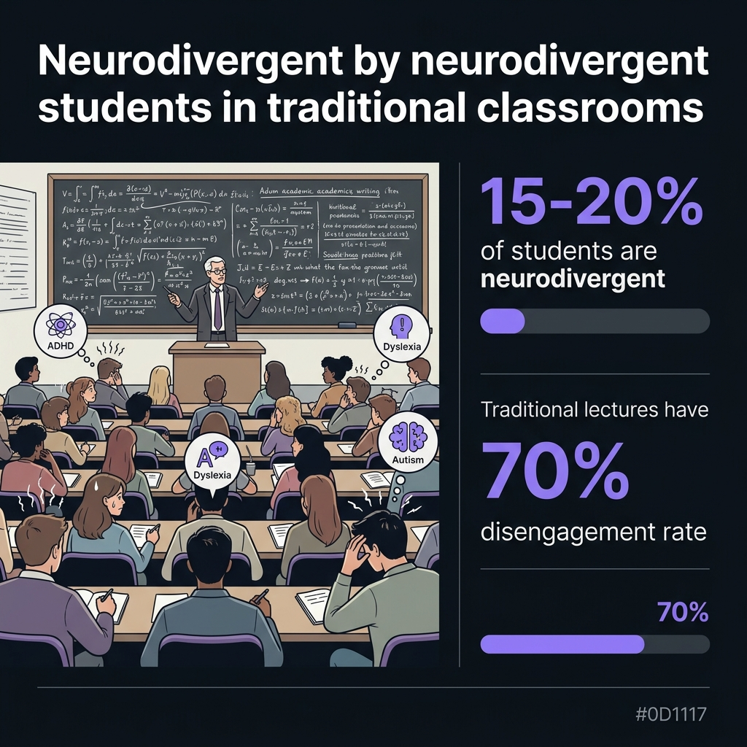
THE PROBLEM
Education Wasn't Designed for Every Brain
15-20%
of all students are neurodivergent
70%
disengagement rate in traditional lectures
$2.4 Trillion
global EdTech market — yet minimal focus on
neurodivergent accessibility
⚡ ADHD students lose focus every 3-5 min • 📖 Dyslexic students need 2-3× more processing time • 🧩 ASD students require structured, literal content

Slide 3
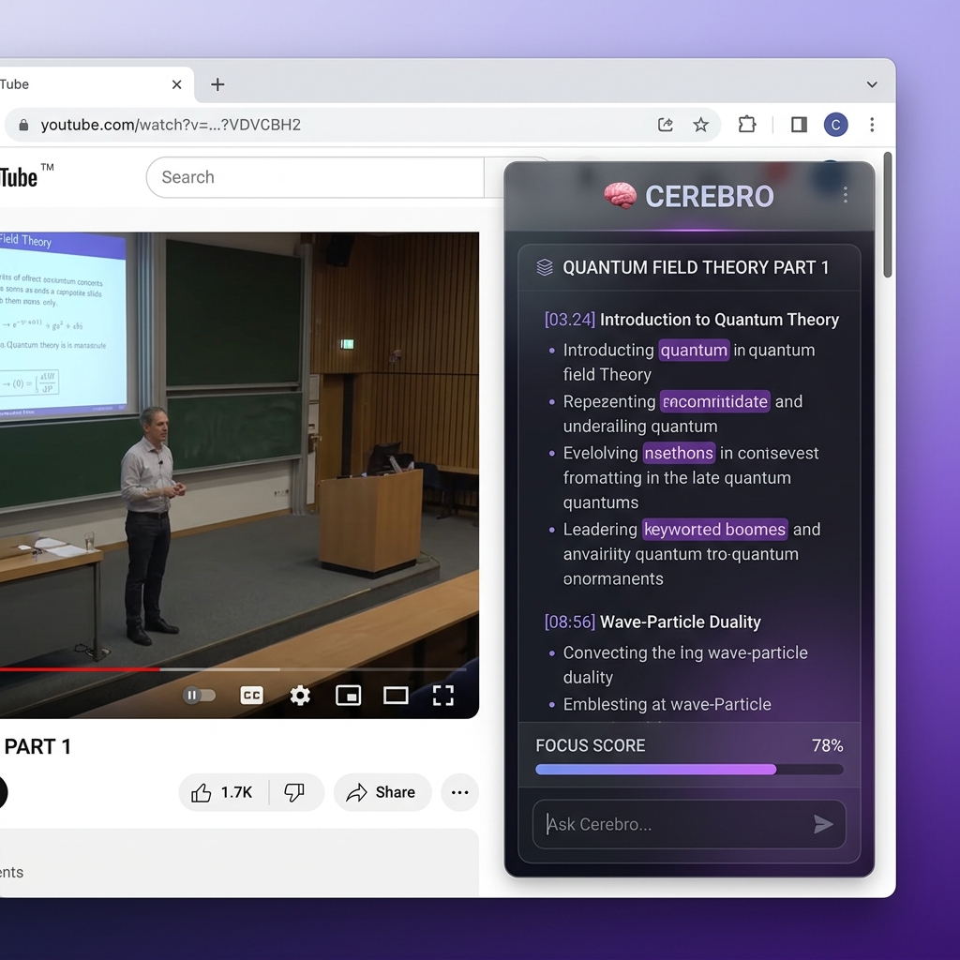
OUR SOLUTION
Cerebro — Your AI Learning Companion
🧠 AI Smart Notes
Real-time transcript → structured, timestamped notes with keyword highlighting & one-click simplification
⏸️ Smart Pause
Detects tab switches, alt-tabs & inactivity — auto-pauses video and generates AI catch-up summary
❓ Quiz Generator
AI creates MCQs from lecture content for active recall — the #1 study technique
⏱️ Pomodoro Timer
Focus timer with auto-pause, break reminders & session tracking for sustained attention
📊 Engagement Score
Interaction-based focus tracking — no webcam needed. Streaks & session stats
🔄 Cloud Sync
Firebase-powered sync across devices. Your notes, everywhere.

Slide 4
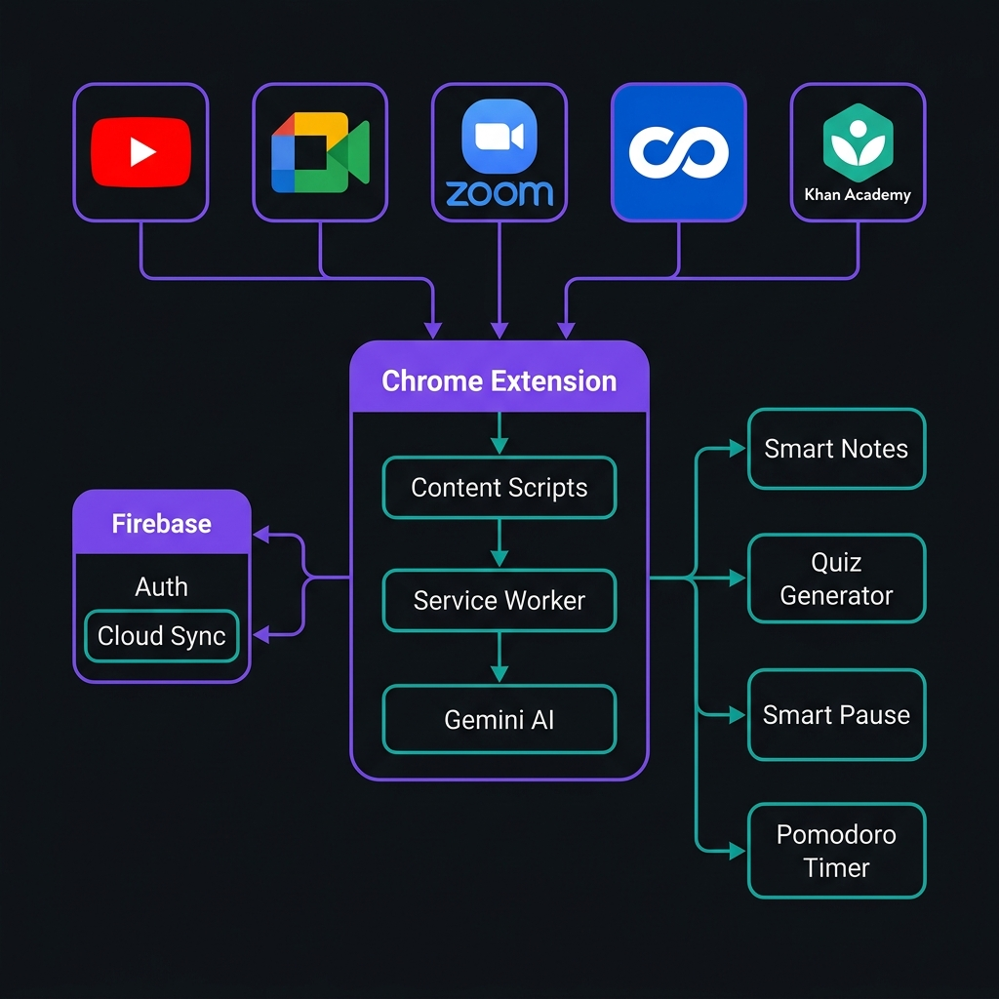
IMPLEMENTATION
Architecture & Technical Details
TECH STACK
Extension
Chrome Manifest V3 — Side Panel API
Vanilla HTML/CSS/JS, no build step
AI Engine
Gemini 2.0 Flash — Structured JSON Output
Notes + Keywords + Quiz in a single API call
Transcription
Smart Dual Strategy — Zero-cost where possible
YouTube: native captions | Meet/Zoom: audio capture
Backend
Firebase Auth + Cloud Firestore
Google Sign-In via chrome.identity, real-time sync
Focus Tools
chrome.alarms + visibilitychange API
Pomodoro, Smart Pause, Engagement tracking
💡 INNOVATION: Smart Pause detects 5 distraction signals (tab switch, alt-tab, window blur, inactivity, rapid tab-cycling) and generates AI catch-up summaries

Slide 5
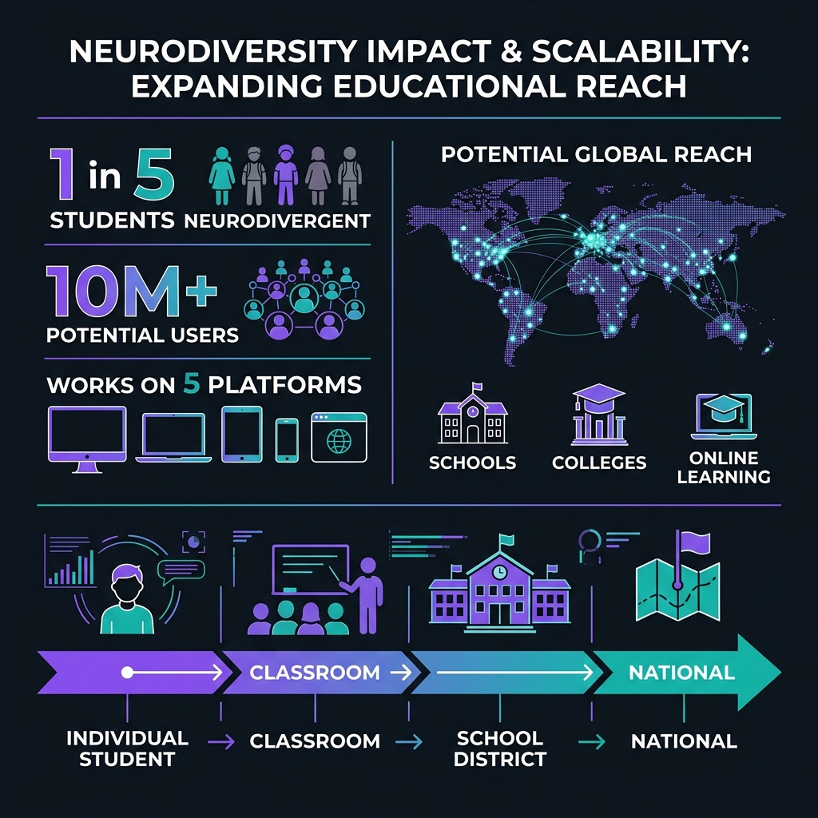
IMPACT & SCALABILITY
Transforming Education at Scale
🎯 Immediate Impact
• Improves accessibility for 15-20% of students
• Reduces note-taking cognitive load by up to 60%
• Increases focus with Smart Pause & Pomodoro
🚀 Scalability
• Chrome Web Store — instant global distribution
• No infrastructure needed — fully client-side
• 5 platforms supported from day one
🔮 Future Roadmap
• Multi-language support (30+ languages)
• Teacher dashboard for class-wide analytics
• Curriculum upload → AI adaptive content
🧠 Cerebro is not just a tool — it's an adaptive learning infrastructure that empowers every student to learn in their own way.
Downloadable today from the Chrome Web Store • Zero setup • Works instantly on YouTube, Meet, Zoom, Coursera & Khan Academy

